Slide 1

E2EE With Lightweight key management in Edge Computing
Kristella B. Jackson
Team RoboSecurity
CECS 574 Section 03 – Topics in Distributed Computing
Professor Pooria Yaghini
12 April 2025

Slide 2

What is Edge Computing?
A distributed computing model
Data storage and computation is close to the source of data
An “extension” to centralized/cloud computing
Decreased Latency
Increase bandwidth
Offloads from the cloud

Slide 3
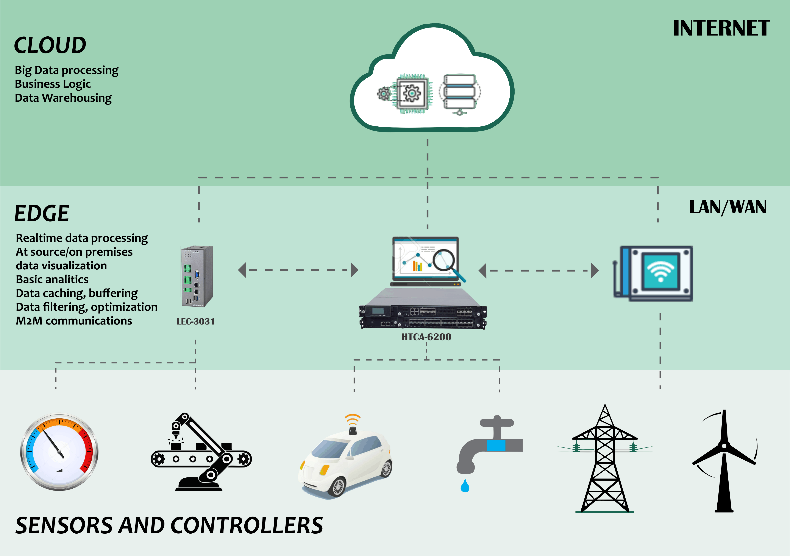
How Edge Computing Is used Today
Notes:
Used for applications that especially require fast-enough response time
Give examples of edge computing applications
Also talk about 5G smartphones counting as edge devices

Slide 4

Data privacy & Integrity risks
Man-in-the-Middle (MitM) attacks
Disguised as both sender and receiver via IP spoofing
Can intercept communication, redirect traffic, and steal/alter sensitive info
Packet Injection Attacks
Can insert (DDoS) and/or deconstruct/modify packets
Focus: How to protect and verify sensitive data over an Edge Network?

Slide 5
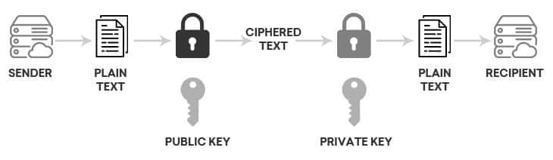
Proposed Solution
End-to-End encryption and verification with Rivest Shamir Adleman (RSA) algorithm
Asymmetric encryption + Digital signature
Public keys exchanged between communicating parties
Private keys must remain private!
Lock with public key, unlock with corresponding private key

Slide 6
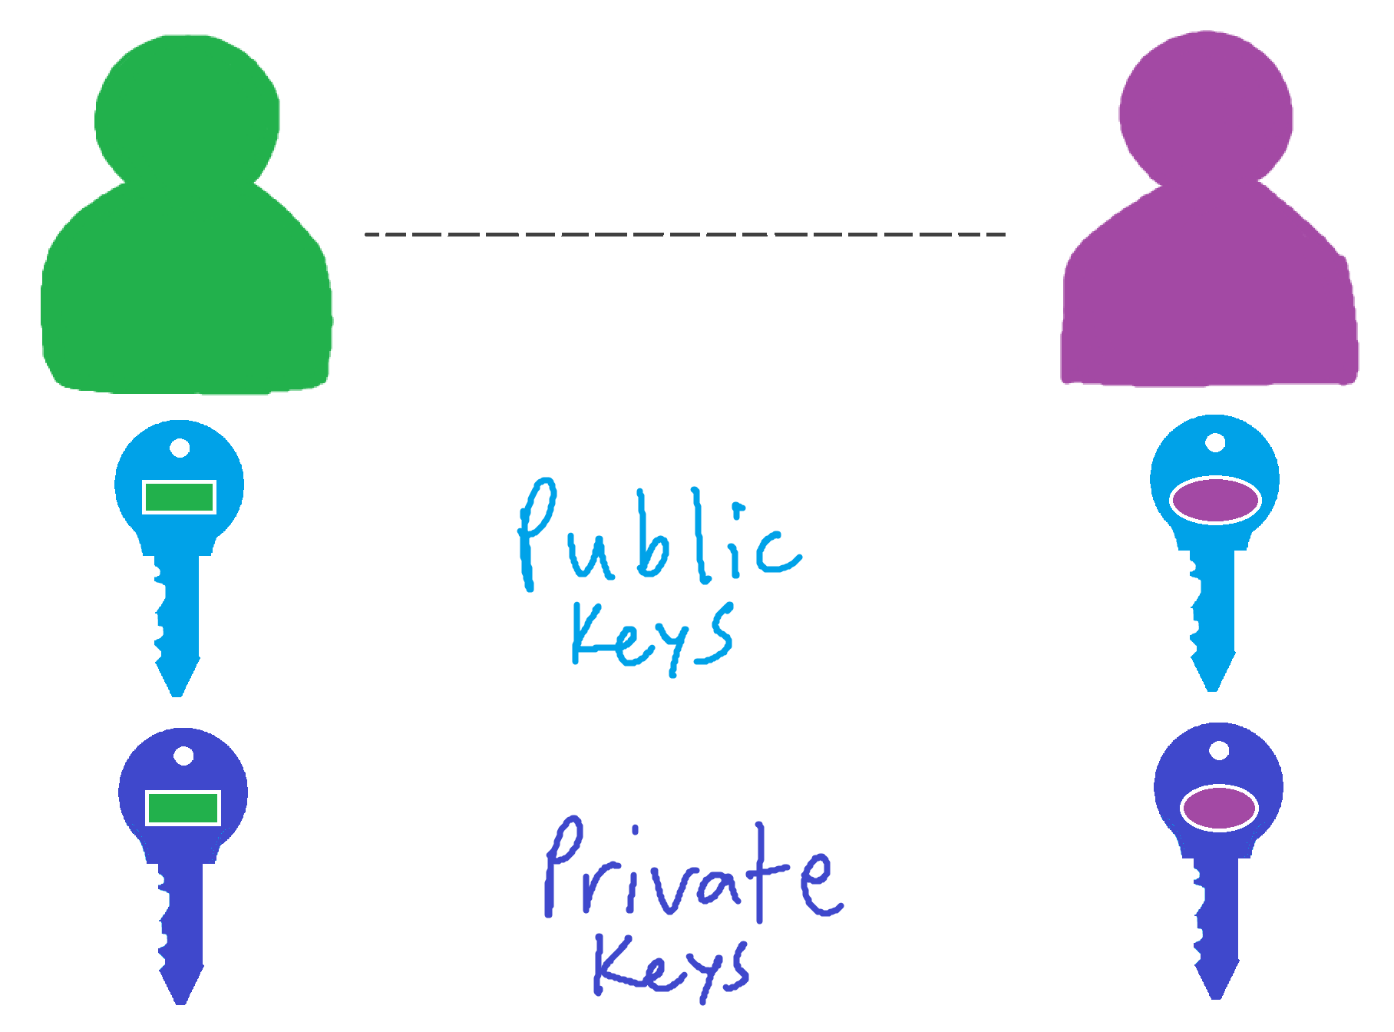
Generate Key pairs

Slide 7
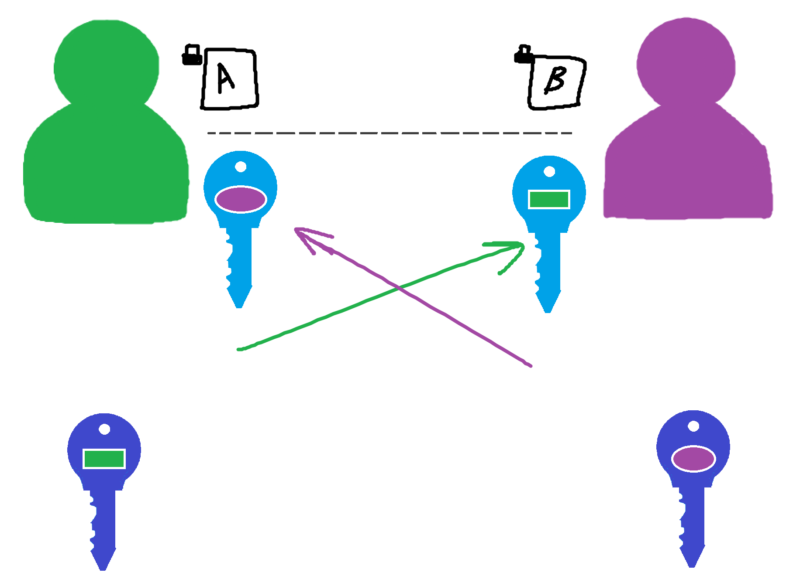
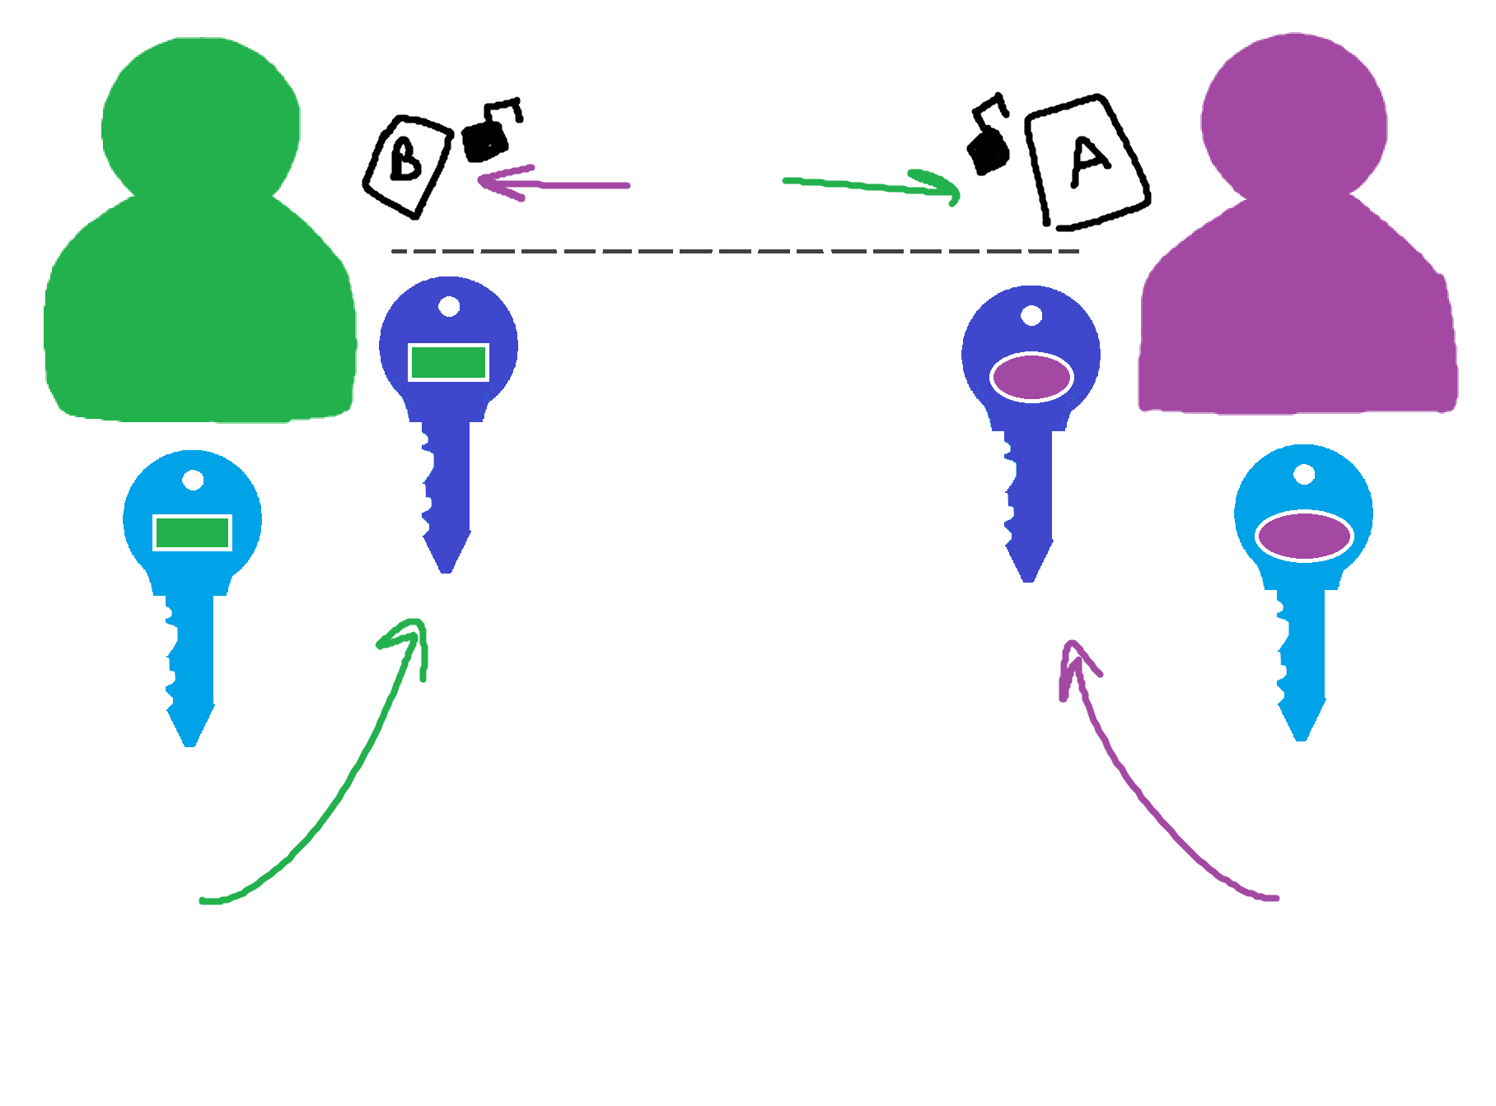
Encryption and Decryption

Slide 8
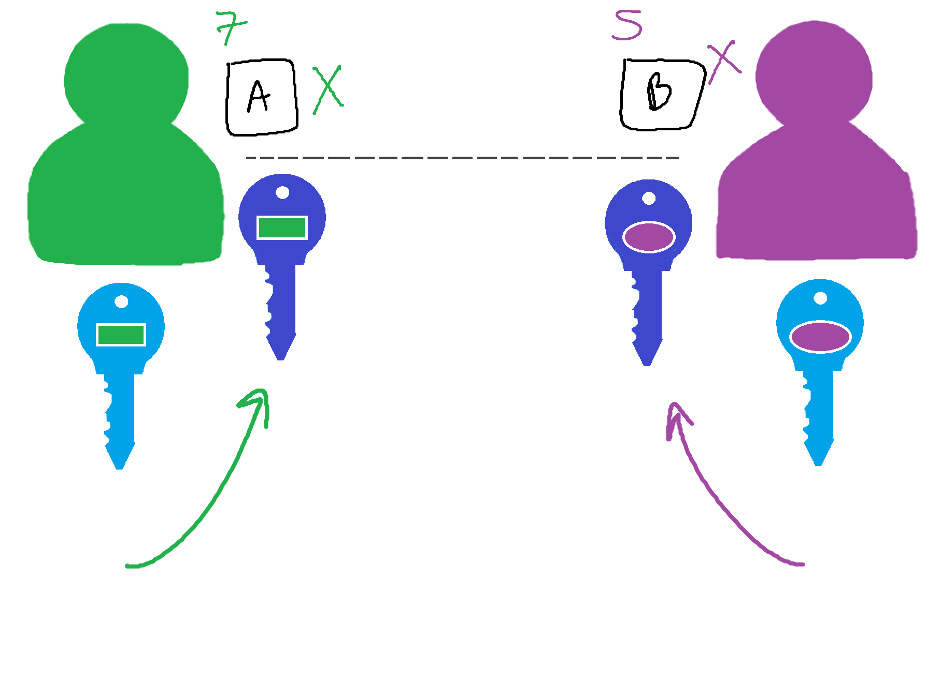
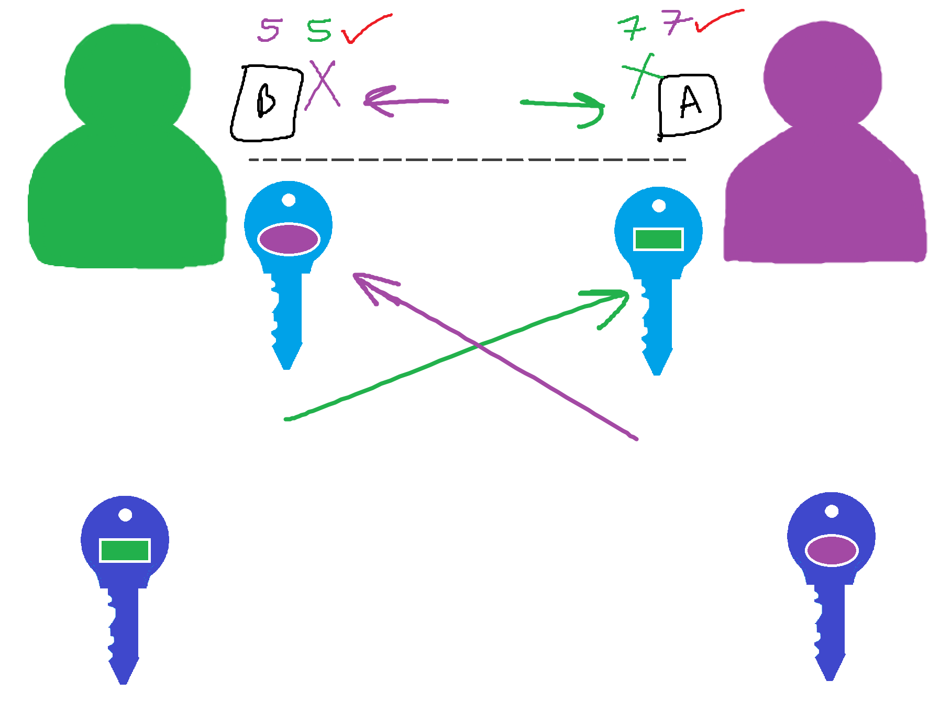
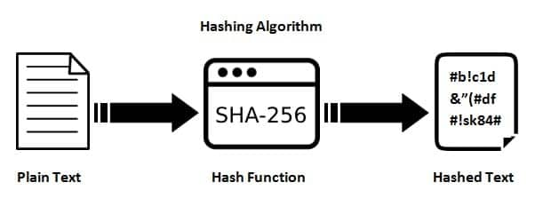
Hash and Signing

Slide 9
RSA Algorithm
Choose two large prime numbers for p and q
Typically between 512 and 2048 bits
Calculate for n [1] and φ(n) [2]
Select e where 1 < e < φ(n) and e is co-prime with φ(n)
Typically between 3 to 65537
Calculate for d [3]
Public Key = (e, n); Private Key = (d, n)
2048-bit key size recommended!
Encrypted text c [4]; Decrypted text m [5]
Signature s [6]; Hash h [7]
n = p*q
Φ(n) = (p-1)*(q-1)
(d*e) % Φ(n) = 1
c = (m^e) % n
m = (c^d) % n
s = (h^d) % n
h = (s^e) % n
Notes:
P and Q are “about the same” size
Φ = phi
E -> encryption; Co-prime: (gcd(Φ(n), e) == 1)
D -> decryption; (d*e)(%Φ(n)) = 1

Slide 10




Implementation
Oracle VirtualBox (v6.1.16)
Ubuntu 20.04
NS3 (v3.42) C++ Library
NetAnim simulator
Wireshark
OpenSSL (1.1.1f) C++ library
Key pair generation
Encryption/decryption
SHA256 + digital signatures

Slide 11
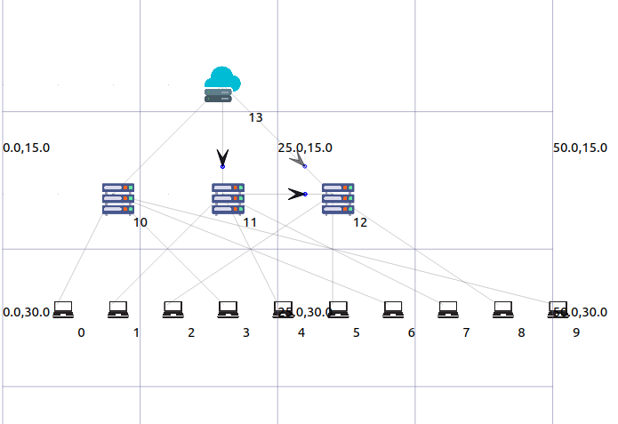

Slide 12
Demo!

Slide 13
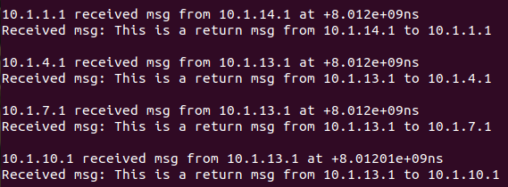
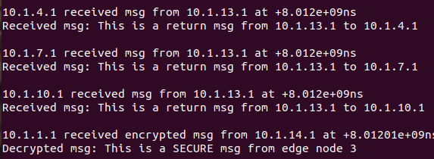
Results
W/o encryption →
10.1.1.1 receives normal message
With Encryption →
10.1.1.1 receives much later

Slide 14
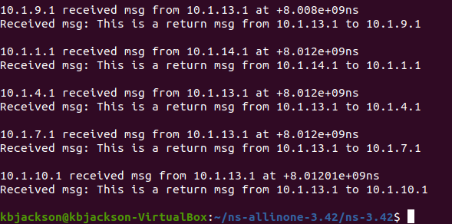
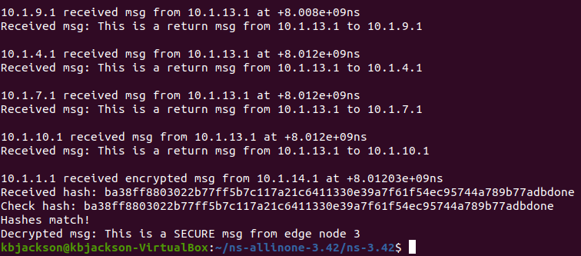
Results
W/o encryption →
10.1.1.1 receives normal message
With Encryption →
10.1.1.1 receives much later

Slide 15
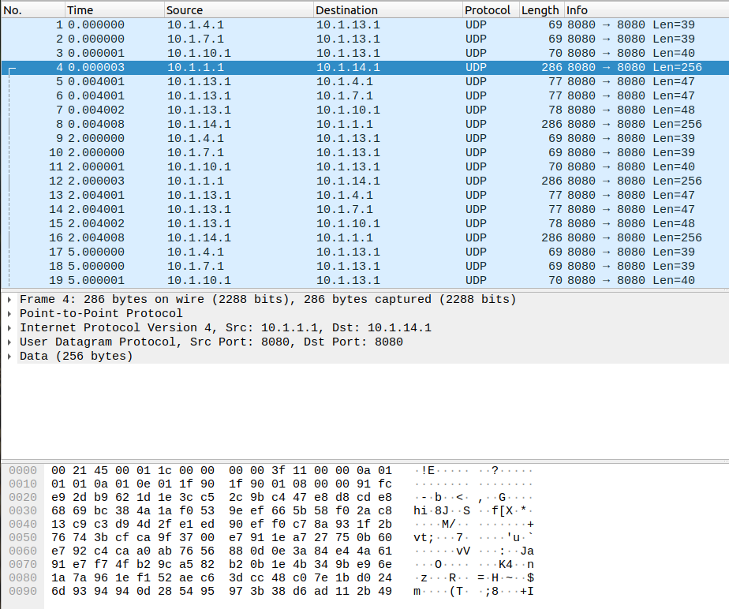
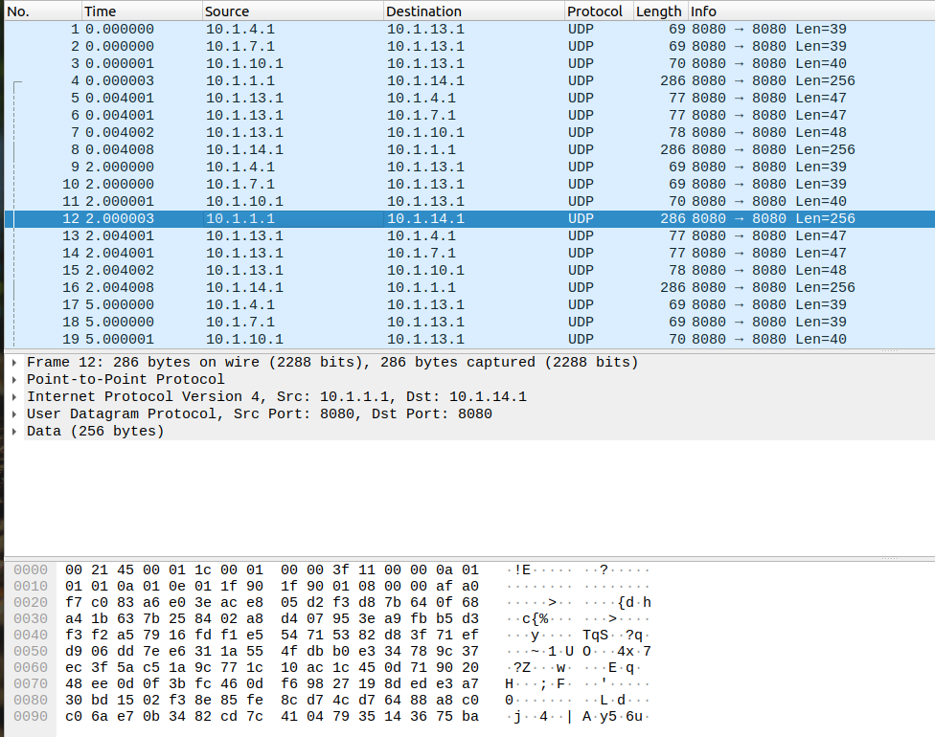
Results

Slide 16
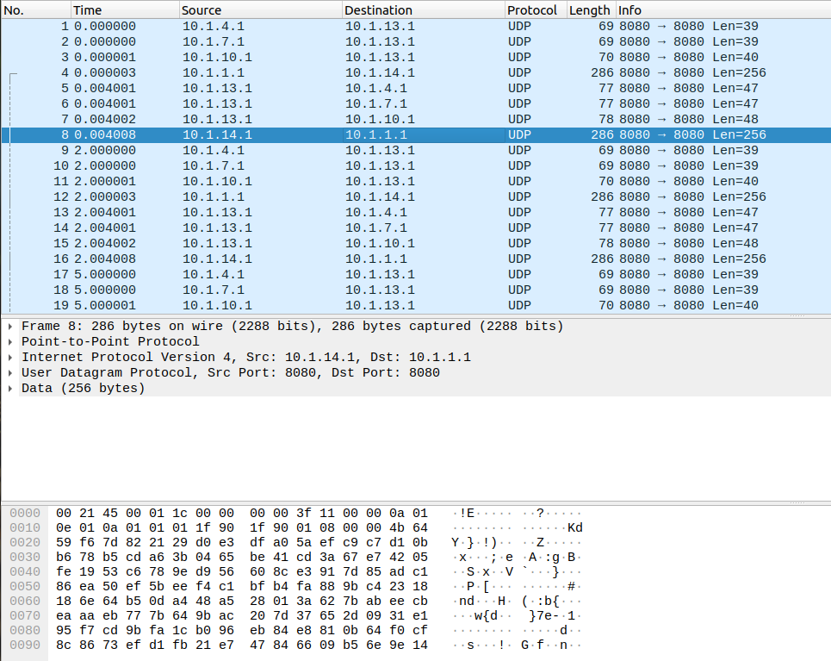
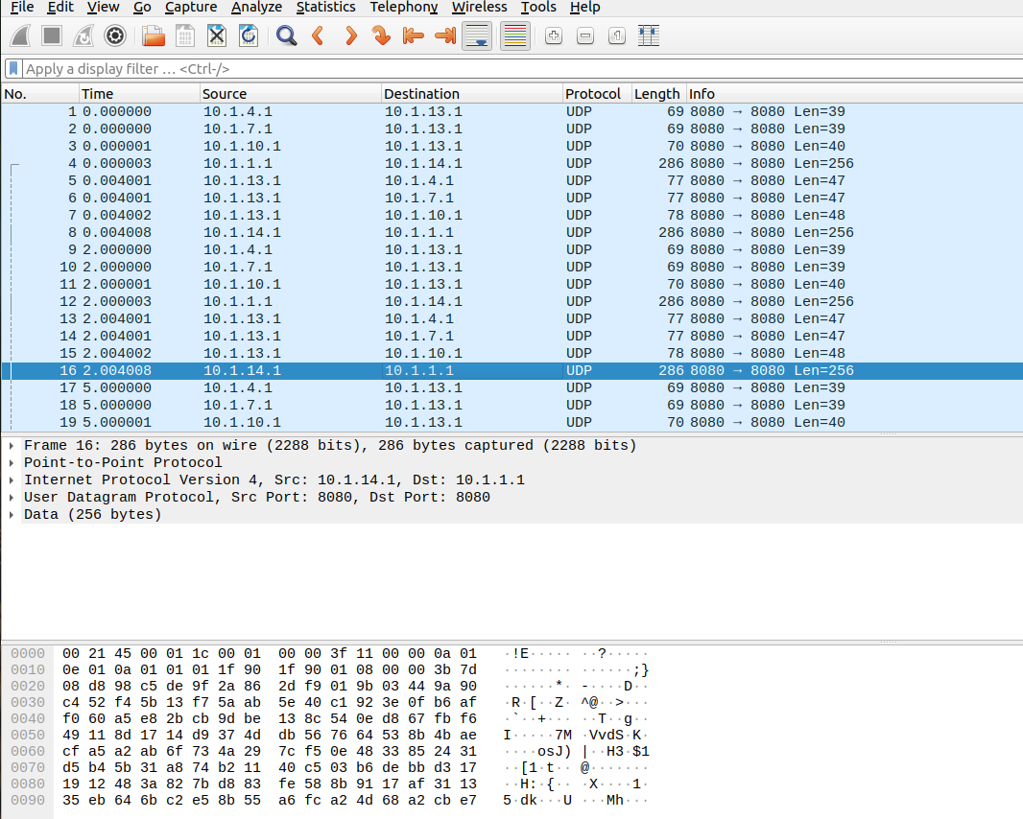
Results

Slide 17
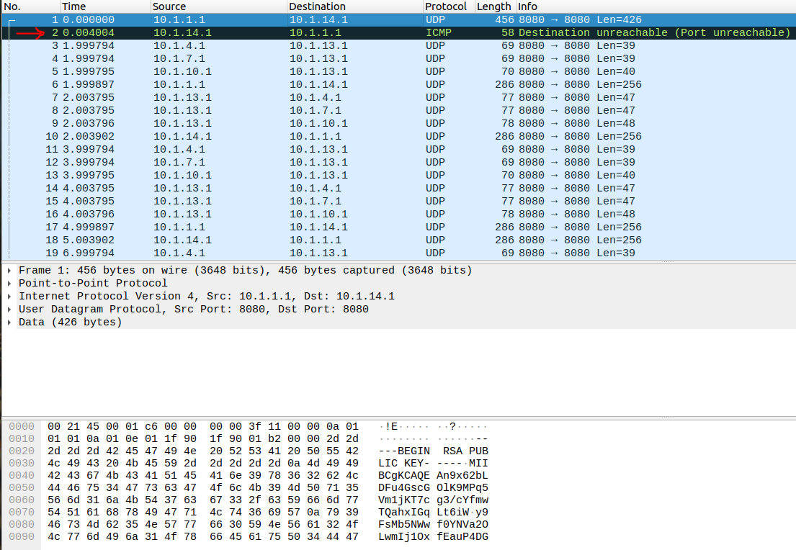
Challenges/Issues
RSA may not be the most secure with 2048 bits later on
Using larger key size
Latency
Elliptic Curve Cryptography (ECC)
Although more complex process
Hash inconsistency
Unrealistic public key exchange application
Trouble with TCP socket connection

Slide 18
Future Works
Safe Key exchange + Consistent hashing and digital signatures
Implement key rotation requirement
Simulate active attacks to further test security
Use NS3’s wifi library to allow more realistic simulation

Slide 19
Thank you!

